Slide 1
Vouchers Presentation
Procedures

Slide 2
INSTRUCTIONS TO WRITE A STORE VOUCHER
Vouchers must be filled out completely! Conference members must sign (or initial) the voucher at the bottom of the document in the “necessity items only” section beneath the list of authorized items for the voucher. Conference members must also date the voucher.
Client must be able to show the same valid ID at the store that was noted on the voucher. Altered vouchers will not be accepted.
Complete the conference information on the top left of the voucher.
Write out a dollar amount or N/A (e.g., One hundred dollars) as well as a number $100.00 unless it is for a change of clothes then N/A can be written in both sections.
Fill out Client information including ID information.
Fill out Vendor information SVdP Thrift Store or ST. Vincent de Paul Thrift Store. A specific store location does not need to be referenced but can be. Vouchers are valid at all stores, regardless.
Leave signature line blank. This is where the client will sign when they redeem the voucher.
Fill out the quantity and description (e.g., 2 - sets of clothes for two children). Clothing vouchers do not need a dollar amount, furniture, housewares, bedding etc. do.
Conference member should sign or initial below the last item at the bottom of the voucher.
10. Separate vouchers should be used for clothing versus other items (i.e., furniture, housewares).
Voucher-Writing-Procedures.pdf

Slide 3
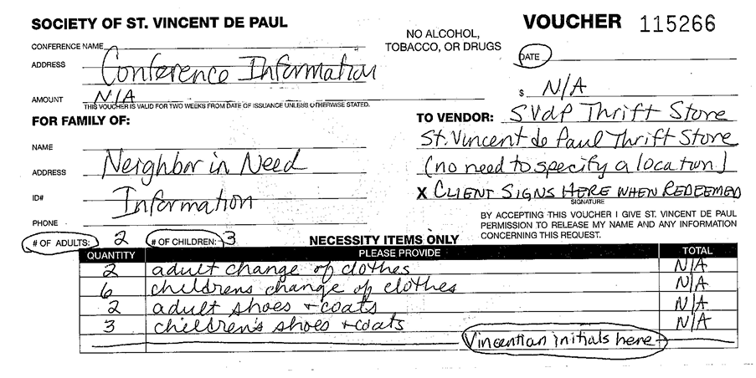
PLEASE complete separate vouchers for no charge clothing versus furniture etc. What is rung up on the register at the thrift store should not exceed the total price listed on the voucher. Your conference will be billed 50% of the total listed on the voucher with the exception of mattresses, box springs and bed frames. Those are billed at full price.

Slide 4
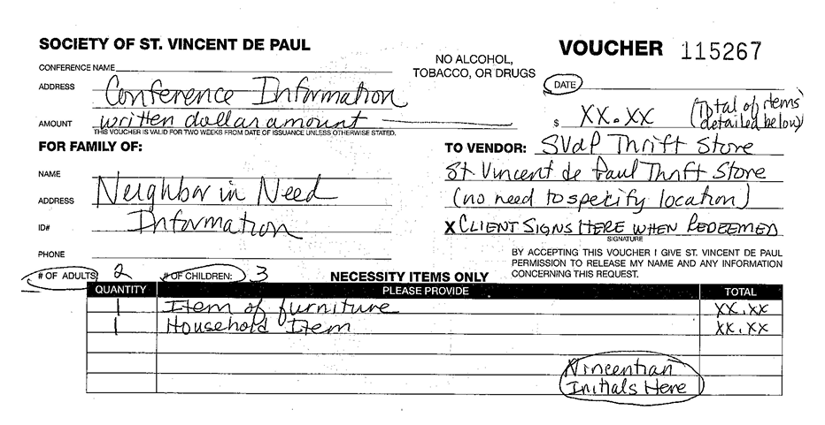

Slide 5
VOUCHER POLICY
GENERAL: “If in doubt, err on the side to benefit the client”
1. Vouchers must be filled out completely! Conference members must sign (or initial) the voucher
at the bottom of the document in the “necessity items only” section beneath the list of
authorized items for the voucher. Conference members must also date the voucher.
2. Client must show a valid ID.
3. Stores will not accept altered vouchers.
4. Vouchers are valid for two weeks and can be redeemed daily until one hour prior to store closing.
Note: the Pittsburg store is closed on Sundays.
5. Clients may receive vouchers for free clothing only once every three months. Any exception
would be at the discretion of the referring Conference.
6. If the staff suspects that a client is abusing a voucher they may hold that voucher until they can
verify the information with the conference.
7. Separate vouchers must be written for clothing and household/furniture goods.

Slide 6
The following are policies per category:
CLOTHING VOUCHERS
Clothing is free for Conferences but members should use this benefit prudently.
2. Clients have access to ALL clothing regardless of name brand or type.
3. “One or two changes of clothing” include pants and shirt or dress. If needed, jackets or shoes
should be listed separately. Number of adults and/or children should be specified on the
voucher.
4. Vouchers for clothing should not show a dollar amount. (enter N/A in $ amount).

Slide 7
B. HOUSEHOLD/FURNITURE VOUCHERS:
1. Vouchers will be honored for only the items listed. List all items and a maximum dollar value.
For example, a complete bed would be a mattress, box spring and frame. The client should first
present the voucher to the store staff so that staff can work with the client.
2. The Conference receives a 50% discount on items that are considered necessary with the
exception of mattresses, box springs and frames. This includes most furniture, houseware items
and bedding. Items not considered necessary (i.e. TVs, radios, musical instruments or newly
purchased items) will be charged to the Conference at the store price.
3. Conferences may take advantage of sale items. Cost to the Conference will be at sale or discount
price whichever savings is greater.
4. Voucher amount listed should be what the client will be rung up for at the point of sale. Note
that the conference will be invoiced for 50% of that charge noting the exceptions in item 2
above.
Voucher-Policy-1-17-19.pdf

Slide 8
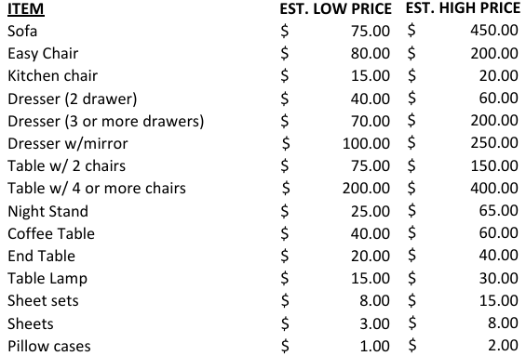
VOUCHER PRICING GUIDELINES - OCTOBER 2023
Prices will vary depending on the age and condition of the items available.

Slide 9
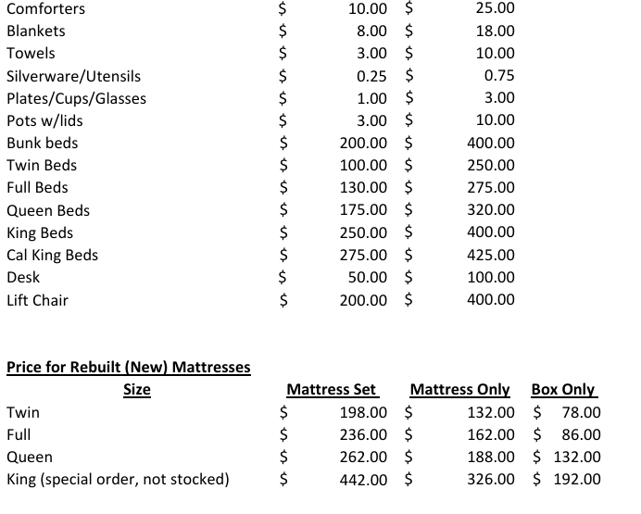
Conference-Store-Price-Guidelines-10-23.pdf

Slide 10
NEW VOUCHER LAYOUT

Slide 11
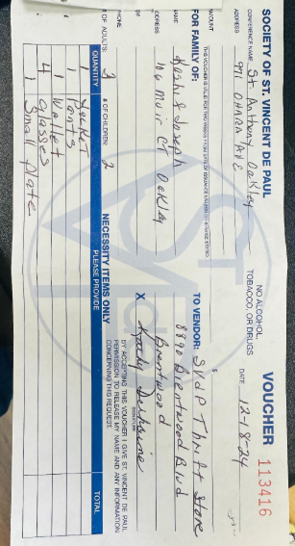
No total for a charge voucher
No Vincentian’s initials
Vincentian signature in the wrong area
Both charge and no charge items

Slide 12
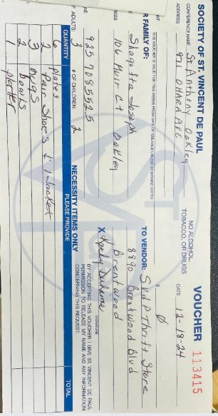
No total for a charge voucher
No Vincentian’s initials
Vincentian signature in the wrong area
Both charge and no charge items
Neighbors in need get one voucher every three months

Slide 13
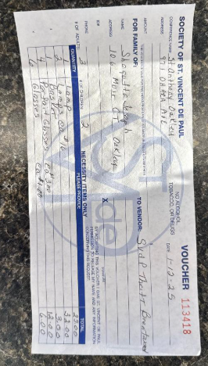
No total for a charge voucher
No Vincentian’s initials
Do not be specific

Slide 14
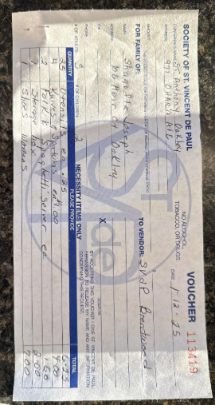
No total for a charge voucher
No Vincentian’s initials
Both charge and no charge items
If you use multiple vouchers, please write 1 of 2, 2 of 2 and so on
Do not be specific

Slide 15
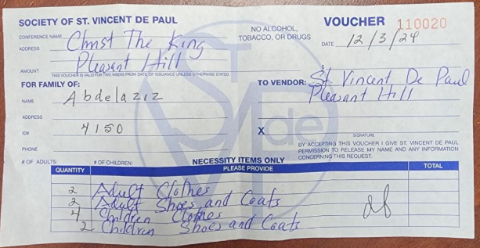
No total for a charge voucher
No # of adults or children

Slide 16
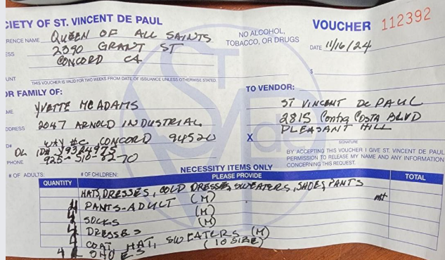
No total
No # of adults or # of children
No initials on corrections
Do not provide sizes

Slide 17
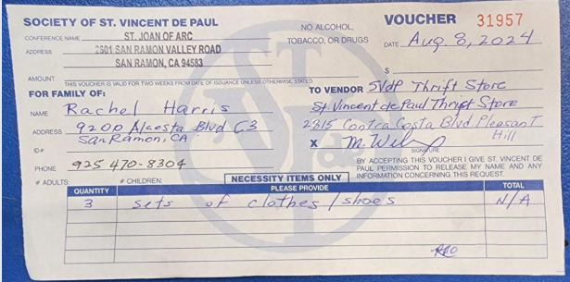
Vincentian’s initials in wrong area
No # of adults or children

Slide 18
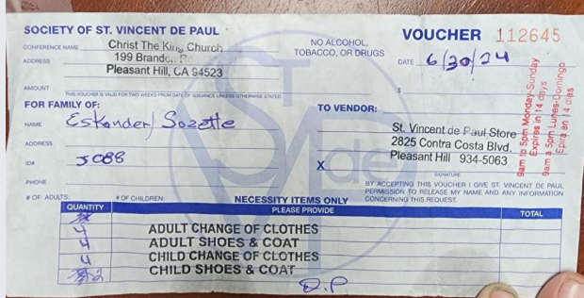
No total for a charge voucher
No Vincentian initial on corrections
No # of adult or children
Wrong store hours

